Slide 1
nSTRIDE™ Autologous Protein Solution
Once OA Pain Starts, It’s Hard to Stop.

Slide 2
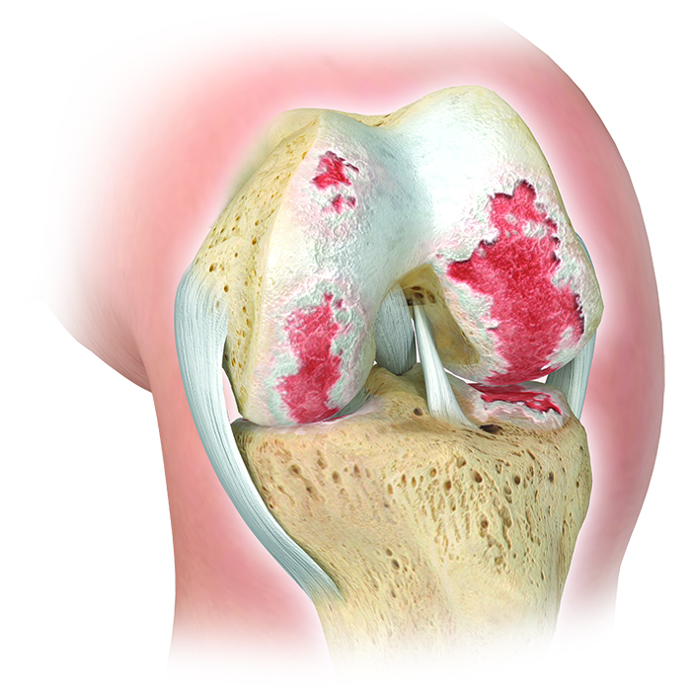
Osteoarthritis of the Knee
Arthritic Joint
Knee OA is a complex disease often driven by inflammation and tissue destruction and therefore requires a mixture of anti-inflammatory and tissue healing factors.

Slide 3
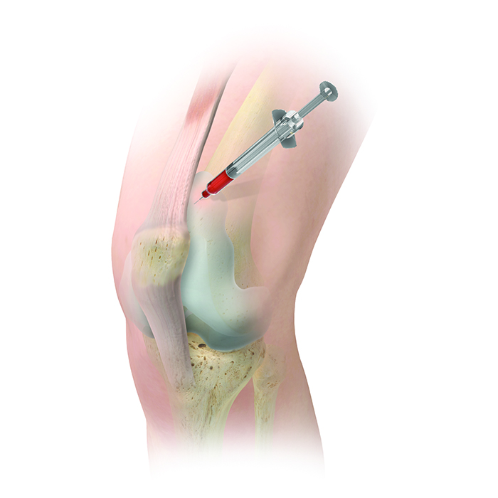
Indication for use
The nSTRIDE Autologous Protein Solution (APS) Kit is designed to be used for the safe and rapid preparation of APS from a small sample of blood at the patient’s point-of-care. The APS is to be injected into the knee joint for the treatment of knee osteoarthritis.

Slide 4
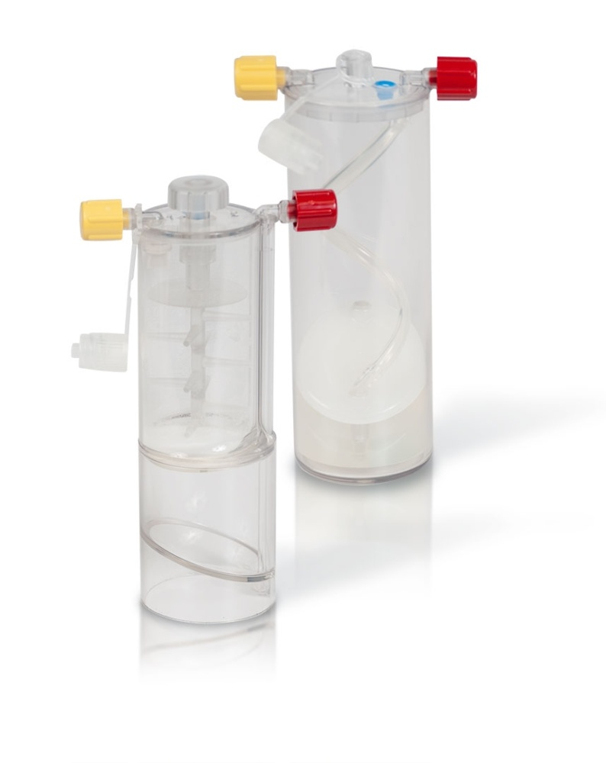
Device Description
The nSTRIDE APS Kit is a self-contained, sterile-packaged, single-use, disposable device designed to isolate anti-inflammatory proteins and growth factors from whole blood. The device is to be used at the point-of-care to create an autologous solution.

Slide 5
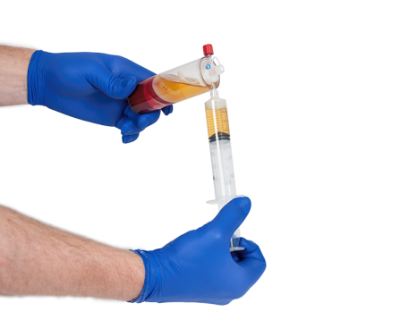
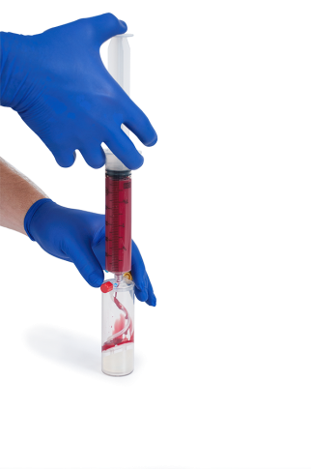
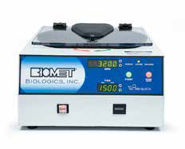
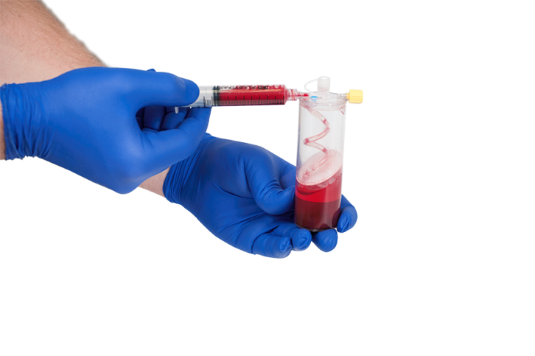
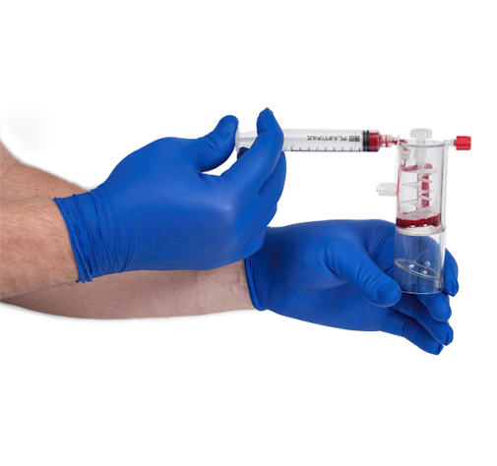
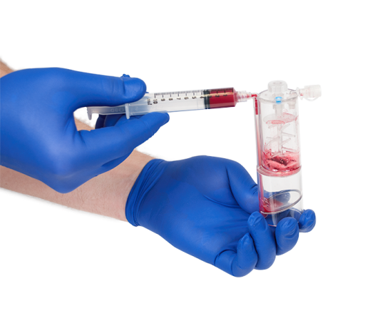
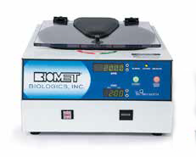
APS Process
Load Cell Separator
Centrifuge
Prepare cells
Final product for injection
Load APS Concentrator
Centrifuge

Slide 6
The APS is to be injected intra-articularly for the treatment of your knee osteoarthritis.
The treatment contains high concentrations of anti-inflammatory proteins(good) and it has been shown to block inflammation and prevent cartilage degradation^{1^}
APS may reduce pain and improve function²*^{,3}

Slide 7
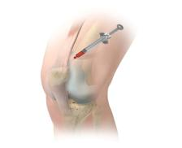
Addressing Your Knee Pain
Proposed solution
Autologous
Protein
Solution
Protein imbalance in knee OA joint
“Good” versus “Bad”
“Good”
anti-inflammatory
proteins
+ healing factors
“Bad”
inflammatory
proteins

Slide 8
The treatment contains high concentrations of anti-inflammatory proteins…
“Bad” Proteins
“Good” Proteins
These high concentrations of “good” proteins have shown to block inflammation and prevent cartilage degradation.
“Good” proteins attach to knee cells and balance is restored.

Slide 9
Scientific Rationale
IL-1α - BAD
IL-1β - BAD
Anti-inflammatory proteins “block” inflammatory proteins to provide pain relief
IL-1ra - GOOD
IL-1ra - GOOD
cell receptors
Knee cell

Slide 10
Potential Benefits
Significantly reduces pain associated with Knee OA^{2*,3}
Significantly improves Mobility in the Knee Joint^{2*} associated with Osteoarthritis
Stimulates Cartilage Cell Proliferation^{1^}
Blocks Cartilage Destruction^{1^}
Slows Cartilage Degradation^{1^}
Point-of-Care
Single injection

Slide 11
Intra-Articular Injection for the Treatment of Early Knee Osteoarthritis

Slide 12
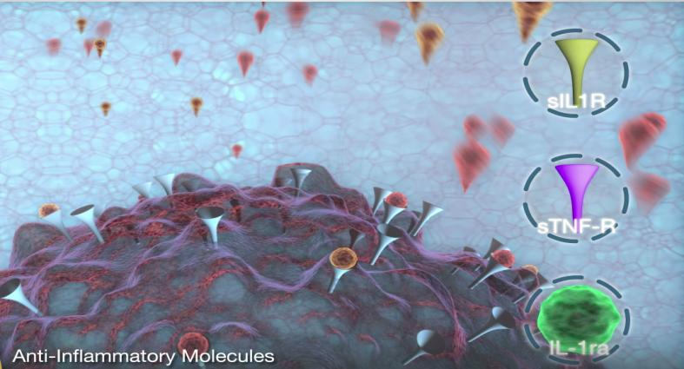
Video
This video is already routed and approved
NSTRIDE Video

Slide 13
FAQs
Are there side effects?
You may experience side effects (e.g., bruising, local pain or swelling) associated with the blood draw, knee injection, MRI or X-Ray procedures.
Is nSTRIDE APS Safe?
Yes. Studies have demonstrated the safety of nSTRIDE APS.^{2*,3}

Slide 14
FAQs
Will I be able to be active as usual during the course of my treatment?
It is recommended that you minimize your activity level for 14 days (but not to exceed pre-injection levels).
Will nSTRIDE APS cure my OA?
There is no cure for OA.⁴ But successful treatment with nSTRIDE APS may reduce or relieve your pain increasing your mobility and comfort.^{2*,3}

Slide 15
FAQs
How long can I expect the benefits to last?
Based on preclinical and early clinical results most patients should expect to see benefits for at least 6 months and potentially lasting 12 months.^{2*,3}

Slide 16
References
Matuska A, O’Shaughnessey K, King, W., Woodell-May J, “Autologous solution protects bovine cartilage explants from IL-1α and TNFα-induced cartilage degradation.” Journal of Orthopaedic Research, 2013;31(12):1929-35.
Bertone AL, Ishihara A, Zekas LJ, et al. Evaluation of a Single Intra-articular Injection of Autologous Protein Solution for Treatement of Osteoarthritis in horses. American Journal of Veterinary Medicine 2014 Feb:75(2):141-151.
van der Weegen W, van Drumpt R, Toler KO, Macenski MM, “Safety and Outcomes Following a Single Autologous Protein Solution injection for Knee Osteoarthritis: A Pilot Study.” International Cartilage Repair Society, #6471, May 8-11, 2015, Chicago, IL.
"Osteoarthritis." : Symptoms & Treatment. Arthritis Foundation, n.d. Web. 20 Apr. 2015. <http://www.arthritis.org/arthritis-facts/disease-center/osteoarthritis.php>.
*Animal studies are not necessarily indicative of clinical performance.
^Cell culture assays are not necessarily indicative of clinical outcomes

Slide 17
Disclaimers
All content herein is protected by copyright, trademarks and other intellectual property rights owned by or licensed to Zimmer Biomet. or its affiliates unless otherwise indicated and must not be redistributed, duplicated or disclosed, in whole or in part, without the express written consent of Zimmer Biomet.
Zimmer Biomet does not practice medicine. The treating surgeon is responsible for determining the appropriate treatment, technique(s), and product(s) for each individual patient.
Not all patients are candidates for this product and/or procedure. Only a medical professional can determine the treatment appropriate for your specific condition. For complete product information and associated risks, talk to your surgeon and visit www.zimmerbiomet.com.

Slide 18
Indications / Contraindications
INDICATIONS FOR USE: nSTRIDE Autologous Protein Solution (APS) with ACD-A (Anticoagulant Citrate Dextrose Solution, Solution A, USP)
The nSTRIDE Autologous Protein Solution (APS) Kit with ACD-A is designed to be used for the safe and rapid preparation of autologous protein solution (APS) from a small sample of blood at the patient’s point of care. The APS is to be injected intra-articularly for the treatment of osteoarthritis.
CONTRAINDICATIONS
Do not inject APS in the knees of patients having knee joint infections or skin diseases or infections in the area of the injection site.
nSTRIDE Autologous Protein Solution (APS) Kit is not for use in patients with systemic inflammatory conditions.
nSTRIDE Autologous Protein Solution (APS) is not intended for use in patients with leukemia, metastatic malignant cells, or who are receiving chemotherapeutic treatment.

Slide 19
Warnings/Potential Adverse Affects
WARNINGS AND PRECAUTIONS
Use proper safety precautions to guard against needlestick injury. Discard used needles in “sharps” containers.
Follow manufacturer instructions when using centrifuge. Use only a Zimmer Biomet Biologics centrifuge (nSTRIDE– IEC centrifuge or The Drucker Company centrifuge). Outcomes using centrifuges from other manufacturers are unknown.
The administering personnel are to be thoroughly familiar with the equipment and the procedure prior to using this device. Strict aseptic administration technique must be followed.
Do not use sterile components in this device system if package is opened or damaged.
STERILE CONTENTS. Single use device. Do not reuse. Use contents of nSTRIDE Autologous Protein Solution (APS) Kit immediately after its packaging is opened.
Only use prepared APS intra-articularly, as directed. NOT FOR DIRECT INTRAVENOUS INFUSION.
Use prepared APS within 4 hours after drawing blood from patient. The safety and effectiveness of frozen stored APS has not been established.
FOR AUTOLOGOUS USE ONLY. Do not use APS allogeneically.
CAUTION: Injection of additional fluids into the knee in conjunction with APS may dilute APS and affect its safety and effectiveness.
Remove all synovial fluid or effusion before APS injection.
INFORMATION FOR PATIENTS
The patient is to be made aware of general risks associated with treatment and the possible adverse effects.
Transient pain, swelling and/or effusion of the injected joint may occur after intra-articular injection of APS.
As with any invasive joint procedure, it is recommended that the patient avoid any strenuous activities or prolonged weight-bearing activities following the intra-articular injection.
POSSIBLE ADVERSE EFFECTS FROM BLOOD DRAW AND INTRA-ARTICULAR INJECTION
Damage to blood vessels, hematoma and/or infection.
Temporary or permanent nerve damage that may result in pain or numbness.
Early or late post-injection infection.
Acute swelling and/or burning sensation at injection site.

